Slide 1
Projects, Procurement
& Money Out
G-CORE · GRUNTECHNOLOGY CORP · TRAINING DAY 2
Project Management · Meetings & Minutes · G-CHAIN Procurement · G-FIN Budget Requests, Liquidations & Reimbursements
9:00 – 12:00 · discussion
1:00 – 4:00 · build a real project
October 15, 2026 · Gruntech Academy · Trainer: Jhon Russel Balicas
Notes:
Welcome everyone. Yesterday’s group was Sales; today is for everyone who runs a project after the sale: project engineers, technical managers, team leaders, procurement, warehouse, back support and finance. This morning we walk through every screen you will use; this afternoon you create a project end to end and we deploy it for real.

Slide 2
Today’s plan, block by block
THE DAY · 9:00 AM – 4:00 PM
Time | Block | What you will be able to do
9:00 – 9:10 | Welcome & the big picture | See how a sale becomes a project, a purchase and a payment
9:10 – 9:25 | Working in G-CORE | Lists, record pages, approvals, My Work, Print
9:25 – 10:20 | Project Management | Costing, job order, project, scope, RFA, accomplishment report, billing
10:20 – 10:35 | Meetings & minutes | Book a meeting, record and agree the minutes
10:35 – 10:45 | Break | —
10:45 – 11:25 | G-CHAIN procurement | PR, RFQ, canvass, PO, incoming, inventory, outgoing
11:25 – 11:50 | G-FIN money out | Budget request, liquidation, reimbursement, cash advance
11:50 – 12:00 | Routes, roles & the afternoon | Who approves what, and the hands-on plan
12:00 – 1:00 | Lunch | —
1:00 – 4:00 | Hands-on: build a real project | Each of you does your part, in your own login, on one live project
G-CORE Training · Agenda
Notes:
Keep to the clock: Project Management is the longest block at 55 minutes because it is where most of today’s people work. Questions that take more than two minutes go to the parking lot and are answered in the afternoon lab. The morning has no slack: if a block runs over, skip its “On screen” slides and show the screen live instead.

Slide 3

One sale, one project, one ledger
THE BIG PICTURE
G-OPS · SALES
G-OPS · PROJECTS
G-CHAIN
G-FIN
Quotation won
Job order → project
Buy & deliver
Pay & account
Costing behind it, sales order booked
Budget, scope, progress, billing
PR, RFQ, canvass, PO, incoming, outgoing
Budget requests, liquidations, reimbursements
Every peso reaches the project through one ledger. Budget Monitoring shows Budgeted − Committed − Incurred = Available. Approved PRs commit, receipts incur, liquidations incur.
G-CORE Training · Big picture
Notes:
The single idea to leave with: nobody types a budget figure by hand. Documents move money. When something looks wrong on Budget Monitoring, find the document that posted it.

Slide 4
Working in G-CORE
PART 1 · 15 MINUTES · 9:10
The same buttons in the same places, on every screen you will touch today.
Notes:
Short block. If people already sat through the sales training, go faster here and spend the saved minutes on Project Management.

Slide 5



Three screens you will meet everywhere
WORKING IN G-CORE
The list
The record page
My Work
Summary cards on top. Search, Mine · Team · All, Filters (chips you can remove). The ⋯ menu: Columns, Export CSV, Print, Save view. Tick rows to print or export only those.
Buttons always in this order: [next step] [Print] [⋯] [Modify]. Rare and destructive actions (Cancel, Delete) live in ⋯ and always ask first in the bar under the header.
Your queue: documents waiting for your approval, your open items, today’s meetings. The bell links straight to the document.
Tip: Ctrl + K finds any record by number or name. The ? Help button in the top bar sends a ticket with a screenshot.
G-CORE Training · Working in G-CORE
Notes:
Demo live: open Projects, flip Mine/All, add a filter, show the chip, open the ⋯ menu, Save view as opening view. Then open any record and point at the button order. Show Ctrl+K.

Slide 6
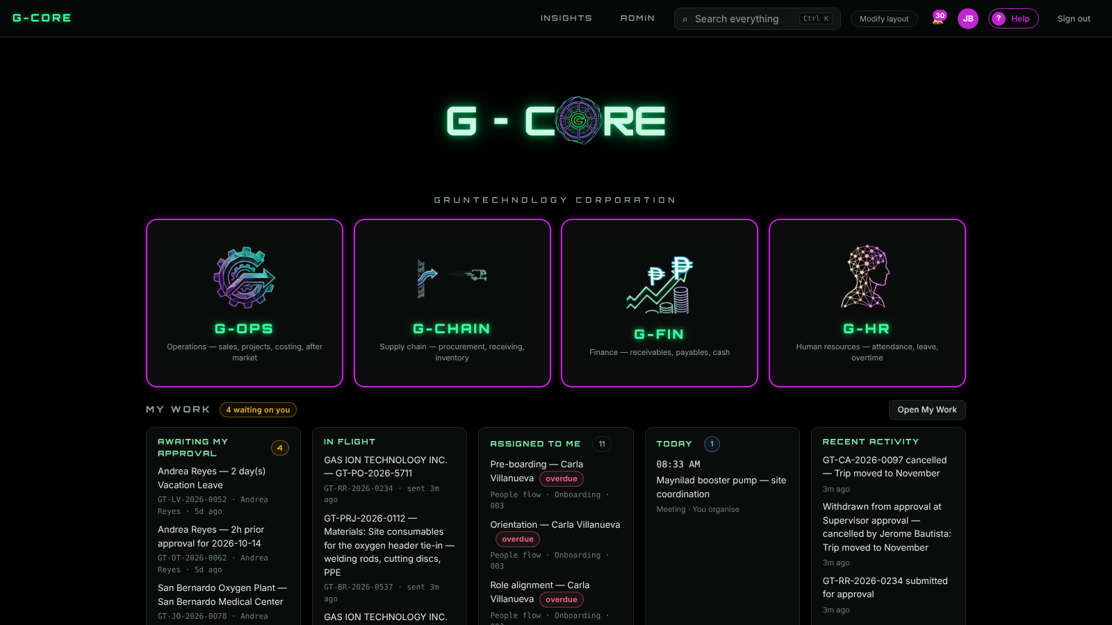
The launcher: four divisions and My Work
ON SCREEN · BASICS
1
Pick a division — G-OPS, G-CHAIN, G-FIN, G-HR.
2
My Work strip: what waits on you, in flight, today.
3
? Help (top right) raises a ticket with a screenshot.
Notes:
Live screen from G-CORE. Point at each numbered item, then switch to the browser and do it for real.

Slide 7
One approval path for every document
WORKING IN G-CORE
1 · Draft → Submit for approval
2 · Approvers decide on the page
Before you send, the page shows “Submit for approval sends it to …” with each step and the person’s name.
The Approval panel offers Approve, Return or Reject — also from My Work. Nobody approves their own document.
3 · Pull back, change, resend
4 · One signature per person
A pending document is never edited behind the approver: ⋯ › Pull back to draft, Modify, submit again.
If you hold a step yourself, it is signed when you submit. Someone holding two steps signs both with one Approve.
G-CORE Training · Approvals
Notes:
Stress: approvals route to ROLES and to “Reports to”. If a document says it cannot be sent because nobody holds a step, it is an admin setup issue, not a bug. Stand-ins: a manager may approve for someone who reports to them, from the document page.

Slide 8
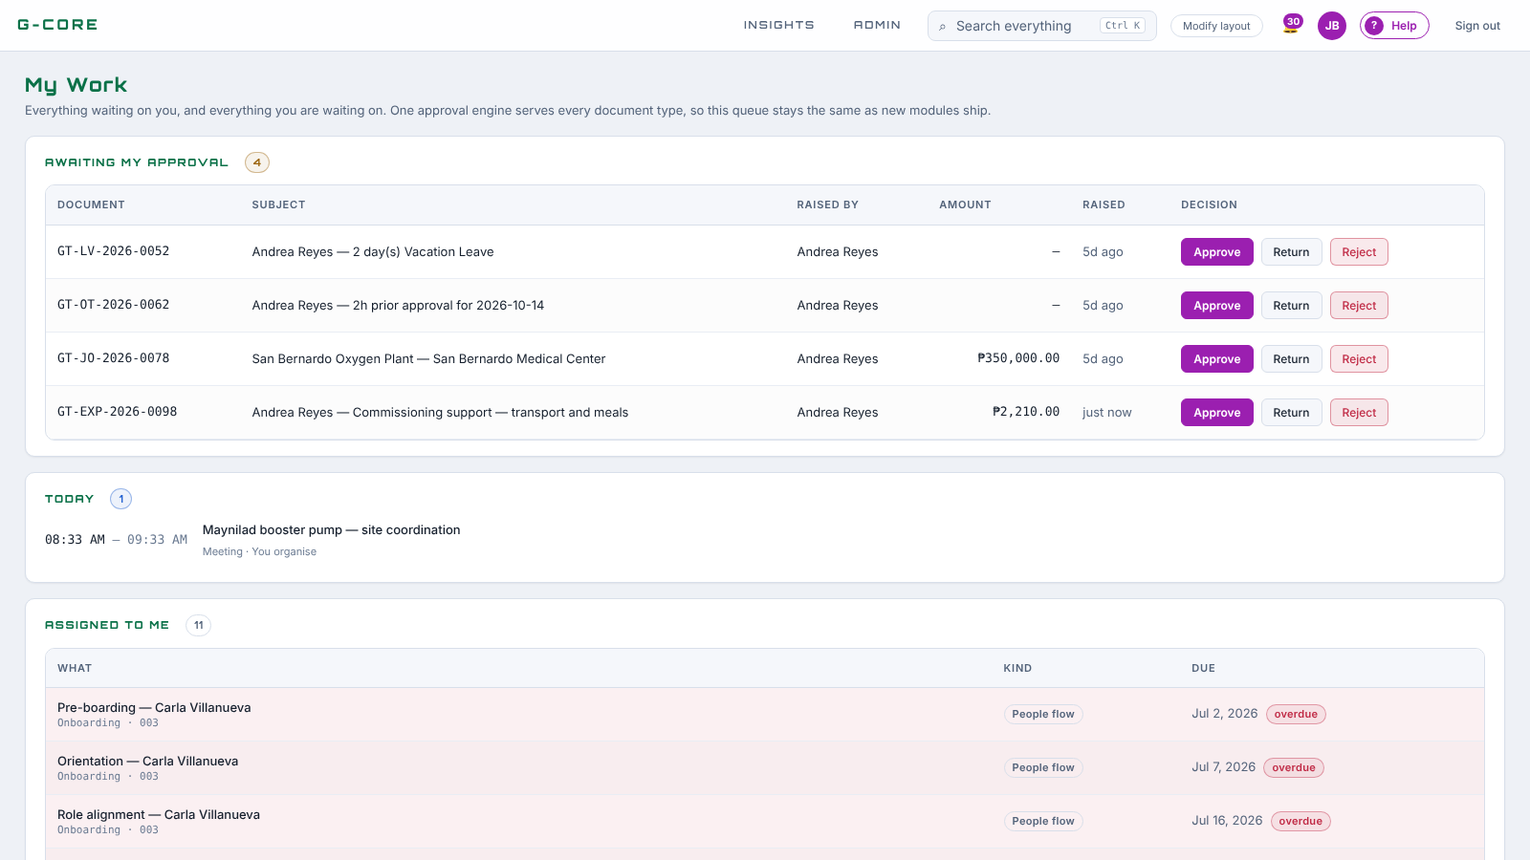
My Work: every approval in one queue
ON SCREEN · BASICS
1
Awaiting my approval — Approve, Return or Reject right here.
2
Today: meetings and activities.
3
Assigned to me: tasks, onboarding, receipts to confirm.
Notes:
Live screen from G-CORE. Point at each numbered item, then switch to the browser and do it for real.

Slide 9
Project Management
PART 2 · 55 MINUTES · 9:25
G-OPS › Project Management: Costing · Projects · Job Orders · CAD J.O.
Notes:
The longest block. Order: the flow, costing, job order, the project and its tabs, scope of work, Request for Approval, accomplishment report, billing.

Slide 10
The project’s life in six steps
PROJECT MANAGEMENT
1
2
3
Costing
Job order
Project built
Engineer prices the work; TM › TL approve; it becomes FINAL
Sales or TL requests the work on the won quotation
Approval by Technical Manager › TL creates the project, budget and scope
4
5
6
Plan & drawings
Accomplishment
Billing
Gantt from the costing; CAD J.O. and Request for Approval
Report per period: weights, daily entries, pictures
Bills only what was added; finance raises the invoice
G-CORE Training · Project Management
Notes:
Purple steps happen before the project exists; green steps happen inside the project page. Everything after step 3 is a tab on the project.

Slide 11
The costing sheet: cost, margin, scope
STEP 1 · COSTING
Lines in six buckets — Materials, Equipment, Labor, Subcon, Indirect, Contingency. Each line can name its supplier and a note.
ROUTE
Margin, not markup. Contract value = cost ÷ (1 − margin). Or set the grand total and the margin follows (fixed price; Release to go back).
Engineer prepares › Technical Manager (of the team) › Team Leader
Scope of work preloaded — Planning & Engineering … Hand Over & Closure. Tasks in working days, Mon–Sat; a start date gives the finish date.
Approved → FINAL. A final costing is locked; Reopen needs a new approval.
Print = “Project Costing” with the Gantt chart as its last page.
Phase value: Spread, Declared, or From cost buckets.
G-CORE Training · Project Management · G-OPS › Costing
Notes:
Demo: + New costing, show the preloaded scope, add three lines, type a supplier, set a start date and watch the finish date, set the grand total. Submit and show the route preview with names.

Slide 12
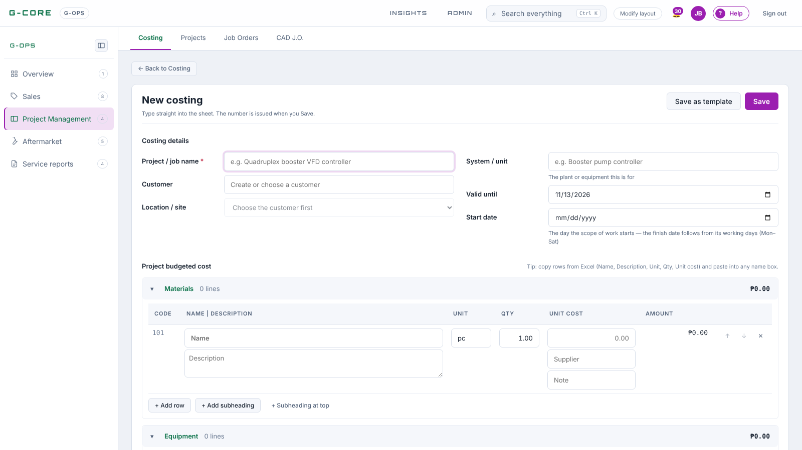
The costing sheet
ON SCREEN · PROJECT MANAGEMENT
1
Header: project, customer, valid until, start date.
2
Lines by bucket: name, description, unit, qty, unit cost.
3
Supplier and Note under each unit cost.
Notes:
Live screen from G-CORE. Point at each numbered item, then switch to the browser and do it for real.

Slide 13
The job order is the project work order
STEP 2 · JOB ORDER
What it carries
How it is approved
Where you see it
Links: quotation, sales order, project
Target start and finish (working days counted)
Scope of work, amount, customer PO
People: Technical Manager (as PM), engineer, lead, support
Raised by Sales or the Team Leader. Route: the Technical Manager named on it as Project Manager › the salesperson’s Team Leader.
The Job Orders list says Project built: Converted once approved. The project page has its own Job Orders tab.
Approval builds the project from the quotation’s costing — name, dates, Technical Manager as its PM, budget, scope.
G-CORE Training · Project Management · G-OPS › Job Orders
Notes:
Common question: “why was no project built?” — the quotation has no final costing behind it. The approval still stands; the requester is told why, and the project can be built by hand from Projects. In the form, the Project manager field takes the Technical Manager — at Gruntech they are the same person.

Slide 14
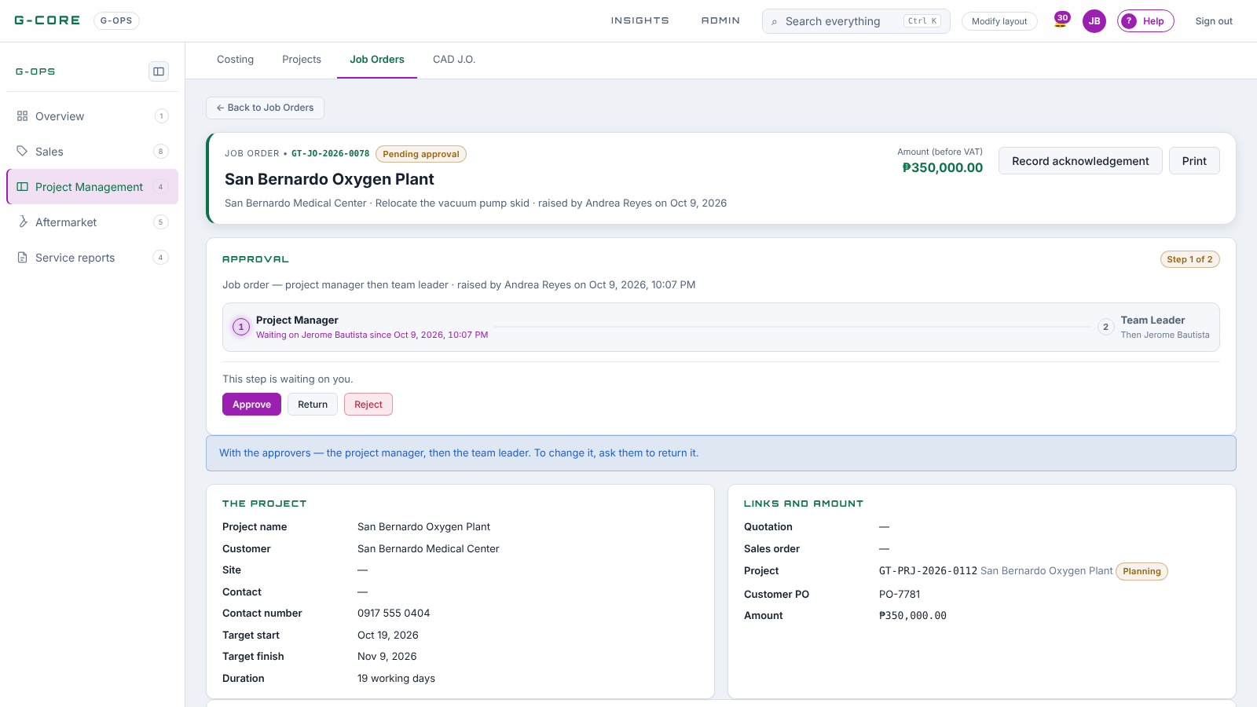
A job order waiting on its approver
ON SCREEN · PROJECT MANAGEMENT
1
The Approval panel: step 1 Technical Manager (the PM), step 2 Team Leader.
2
Approve / Return / Reject on the document itself.
3
Links: quotation, sales order, the project it builds.
Notes:
Live screen from G-CORE. Point at each numbered item, then switch to the browser and do it for real.

Slide 15
Everything about a project, one tab away
STEP 3 · THE PROJECT PAGE
Tab | What it holds
Overview | Progress, billed, budget, expected margin, S-curve, schedule
Costing · Job Orders | The costing it came from (lines, phase weights); its job orders and whether converted
Meetings & Records | Meetings held for the project, their minutes, documents, activity
Request for Approval | Drawings sent for internal approval (TM › TL, CEO over ₱1M)
Budget Monitoring | Budgeted, committed, incurred, available per budget line
Purchase Requisition · Budget Requests | Buying through G-CHAIN, or asking for project cash
Scope of Work · Progress & Billing | The Gantt chart; accomplishment reports and billings
G-CORE Training · Project Management · G-OPS › Projects
Notes:
Open a real project and click through each tab as you read the row. Point out the Available figure on Budget Monitoring — a purchase requisition over it is blocked at submit.

Slide 16
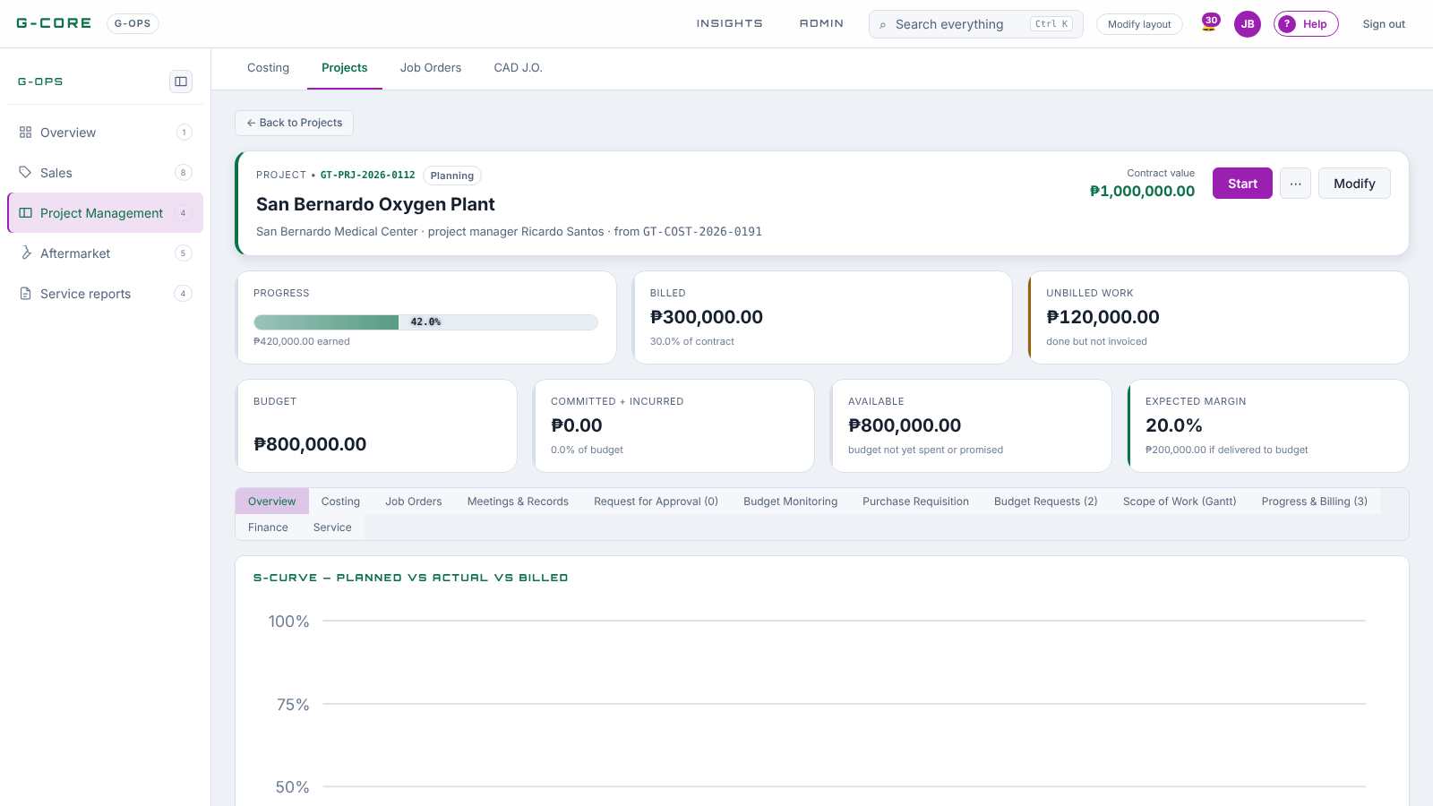
The project workspace
ON SCREEN · PROJECT MANAGEMENT
1
Cards: progress, billed, unbilled, budget, margin.
2
Tabs: Costing, Job Orders, Meetings, RFA, Budget, PR …
3
S-curve: planned vs actual vs billed.
Notes:
Live screen from G-CORE. Point at each numbered item, then switch to the browser and do it for real.

Slide 17



Plan the work on the Gantt chart
STEP 4 · SCOPE OF WORK
Plan from costing
Keep tasks current
It feeds the report
One click writes the costing’s tasks as dated tasks from the project’s start, Mon–Sat. Phases already planned by hand are left alone.
Each task: start, due, status, % complete, assignee — and its weight in its phase (1 if blank).
A phase’s % = Σ weight × progress ÷ Σ weight. The accomplishment report offers it: “Use it”.
Example: Delivery has 3 tasks weighted 2 · 1 · 1 at 100% · 50% · 0% → (200 + 50 + 0) ÷ 4 = 62.5%
G-CORE Training · Project Management · Scope of Work tab
Notes:
Weights say how much of the phase a task is. Delivering the pumps is twice the effort of delivering the manifold, so it carries weight 2. If nobody sets weights, every task counts the same.

Slide 18
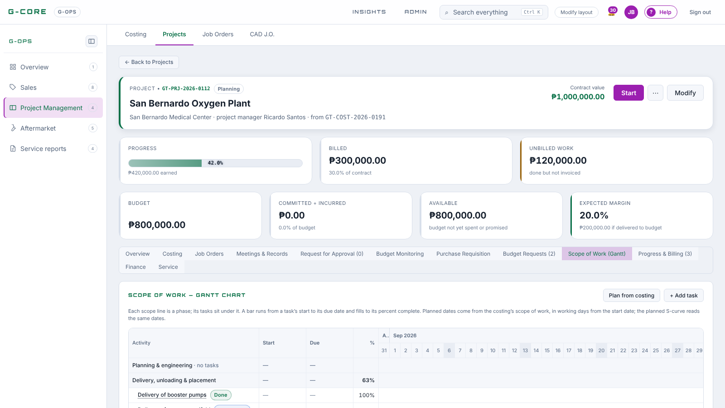
Scope of Work as a Gantt chart
ON SCREEN · PROJECT MANAGEMENT
1
Plan from costing writes the dated tasks.
2
Each phase fills to its weighted progress.
3
+ Add task: dates, weight, who.
Notes:
Live screen from G-CORE. Point at each numbered item, then switch to the browser and do it for real.

Slide 19
CAD J.O. → Request for Approval
STEP 4 · DRAWINGS
CAD J.O. — the design team’s queue
Request for Approval — internal sign-off
Requestor gives scope, files and a needed-by date
Designer Lead assigns; designer sets priority and %
Each revision R0, R1… must carry a PDF
Requestor accepts or asks for changes in the thread
One click from an accepted CAD revision, or + New
Drawing reference, revision, discipline, files
Route: Technical Manager › Team Leader, + CEO over ₱1,000,000
A newer approved drawing supersedes the old one
G-CORE Training · Project Management · CAD J.O. and Request for Approval tab
Notes:
The RFA amount is the project’s contract value, so a project over one million goes to the CEO too. A request cannot be submitted without a file attached.

Slide 20
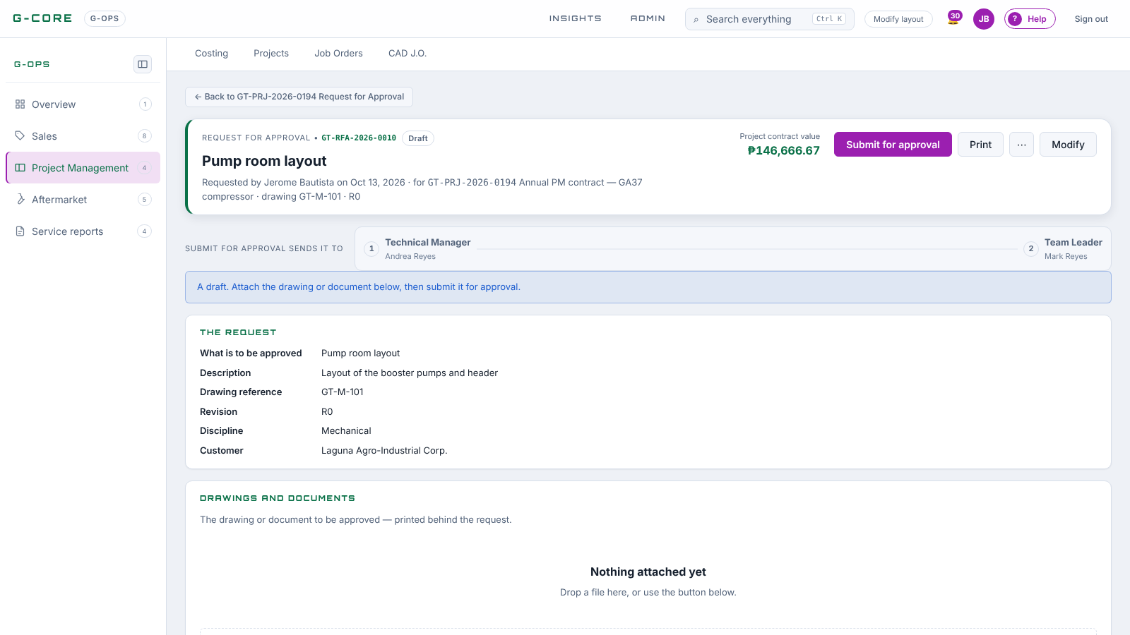
A Request for Approval, still a draft
ON SCREEN · PROJECT MANAGEMENT
1
"Submit for approval sends it to …" names the route.
2
Attach the drawing before submitting.
3
Drawing reference, revision, discipline.
Notes:
Live screen from G-CORE. Point at each numbered item, then switch to the browser and do it for real.

Slide 21
One report per period, weighed by value
STEP 5 · ACCOMPLISHMENT REPORT
Numbered under the project
Weight × to-date %
Daily entries + pictures
GT-PRJ-2026-0112-PR-03 — report 3 of that project. Each carries the last one’s to-date % forward.
Weight = phase value ÷ contract. A 40% phase at 70% adds 28%. The weighted figures add up to the project %.
+ Add day: actions, findings, recommendation, people on site — and attach the day’s pictures.
Modify fills the narrative
ROUTE
Overall status (On schedule · Ahead · Behind · Ongoing – For corrective works · On hold · Completed) + a note, personnel present, Summary, Key milestones, Remaining works, issues, manpower, weather.
Creator (Project Engineer or Sales) › Technical Manager › Team Leader
Print = the Accomplishment Report with pictures, 3 to a row
G-CORE Training · Project Management · Progress & Billing tab
Notes:
Demo the report page: the weighted table, “Use it” from the tasks, + Add day, attach two pictures, Modify the narrative, then Print to show the paper. Only one report may be open at a time per project.

Slide 22
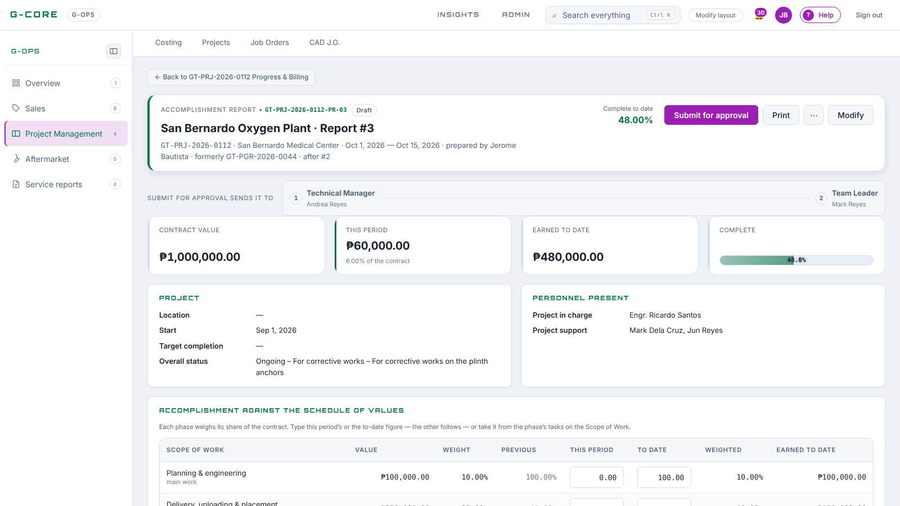
The Accomplishment Report
ON SCREEN · PROJECT MANAGEMENT
1
Number under its project: …-PR-03.
2
Overall status, personnel present.
3
SOV lines weighted by value; Use it from tasks.
Notes:
Live screen from G-CORE. Point at each numbered item, then switch to the browser and do it for real.

Slide 23
Bill only what the report added
STEP 6 · PROGRESS BILLING
From an approved report: Raise billing. It compares each phase’s to-date % with the highest already billed — billing the same work twice is impossible.
THE MONEY BLOCK
Line | Example
Gross (work this period) | 100,000.00
VAT 12% | 12,000.00
Invoice total | 112,000.00
Less: EWT 2% (on gross) | (2,000.00)
Net collectible | 110,000.00
Same route as the report: creator › Technical Manager › Team Leader. Numbered …-PB-01 under the project.
Approved → finance clicks Raise invoice; the invoice copies the billing’s figures.
G-CORE Training · Project Management · Progress & Billing tab
Notes:
EWT is withheld by the customer at source; the net collectible is what we expect in the bank. A/R never reports the withheld 2% as overdue.

Slide 24
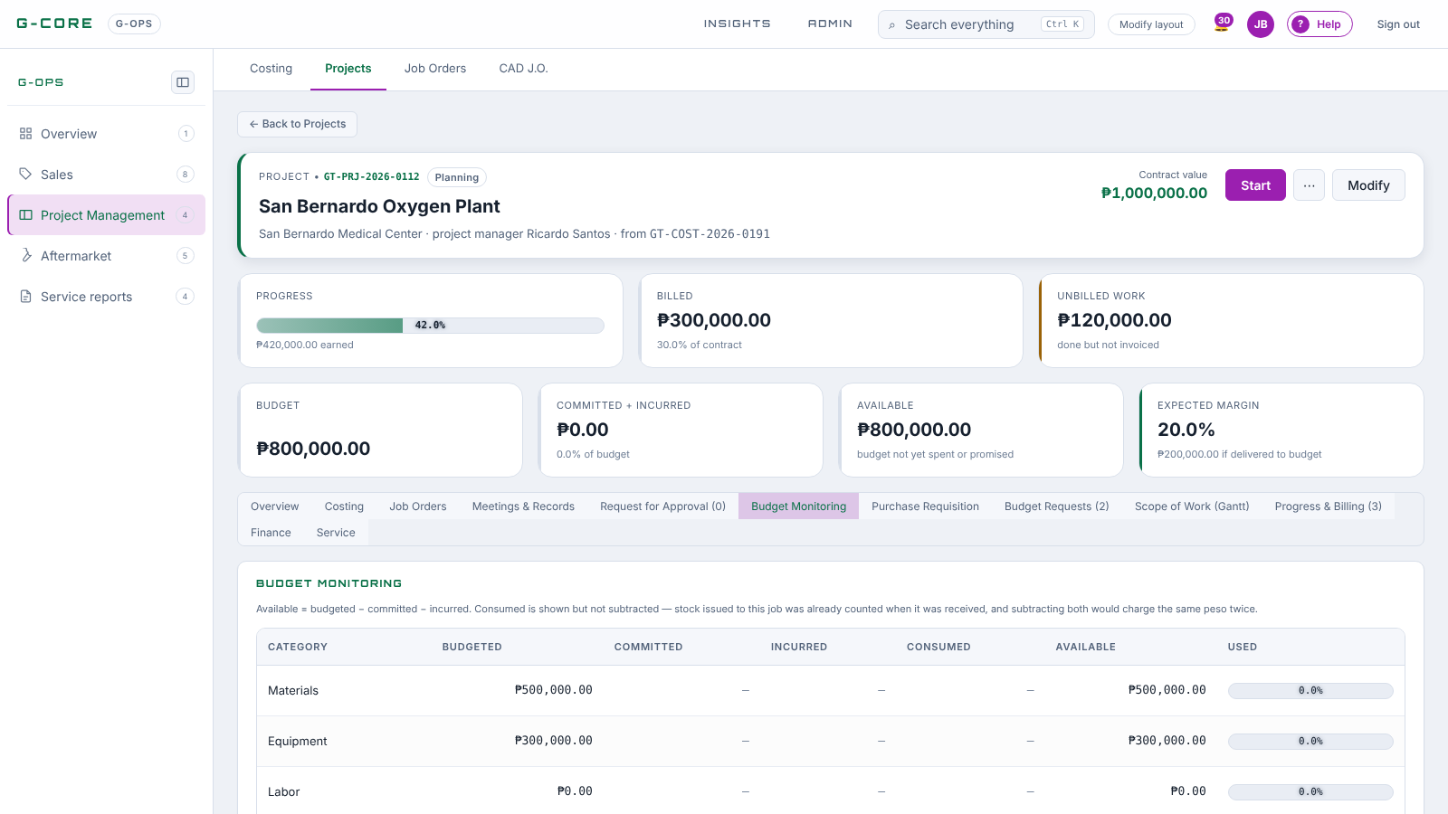
Budget Monitoring
ON SCREEN · PROJECT MANAGEMENT
1
Budget by category from the costing.
2
Committed (PR/PO) and incurred (receipts, liquidations).
3
Available = budget − committed − incurred.
Notes:
Live screen from G-CORE. Point at each numbered item, then switch to the browser and do it for real.

Slide 25
Meetings & minutes
PART 3 · 15 MINUTES · 10:20
G-HR › Meetings — so anyone can trace back what was agreed on a project.
Notes:
Kick-off, site coordination and progress meetings all live here, linked to the project.

Slide 26
Book it, link it, invite people
MEETINGS
+ New meeting
For project
Title, agenda, start and end, where — or a Google Meet link — and a Google Maps link for the site.
Pick the project, or start from its Meetings & Records tab. It then lists there with a Minutes column.
Send invitations
Change or cancel
Saving does not invite anyone. Send invitations tells each invitee, with a calendar file; they answer Going, Maybe or Not going.
A new time tells everyone already invited. Once invitations went out it is cancelled with a reason, never deleted.
G-CORE Training · Meetings · G-HR › Meetings
Notes:
Demo from a project’s Meetings & Records tab: + New meeting pre-links the project. Invite two trainees, send invitations, and have them answer Going on their phones.

Slide 27
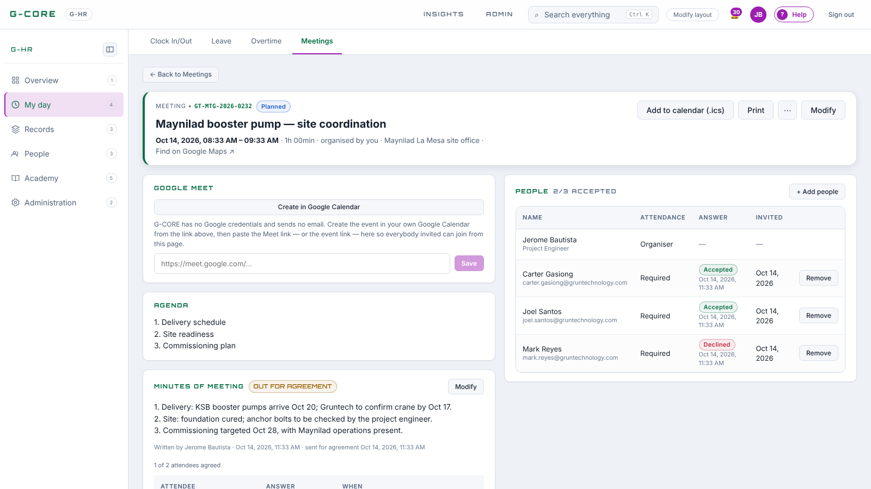
A meeting page
ON SCREEN · MEETINGS
1
Who is going: Accepted, Declined, waiting.
2
Google Meet link and the map link.
3
Agenda, then Minutes of meeting.
Notes:
Live screen from G-CORE. Point at each numbered item, then switch to the browser and do it for real.

Slide 28

Recorded once, agreed by those who attended
MINUTES OF MEETING
1 · WRITE
2 · SEND FOR AGREEMENT
3 · AGREE OR ASK
4 · AGREED
After the start, the organiser or an invitee writes the minutes in the card under the Agenda.
The organiser sends them to everyone who answered Going.
Each attendee Agrees or Asks for a change with a comment.
The last agreement closes it. A later edit sends a new round.
Print = Minutes of Meeting: details, agenda, minutes, attendance, Prepared by and one sign-off per attendee — “Pending” until they agree. Minutes are searchable with Ctrl + K.
G-CORE Training · Meetings · Minutes
Notes:
This is not an approval route: the minutes are a record signed by the people who were there. Use it for kick-off and site coordination meetings so disputes later can be traced to what was agreed.

Slide 29
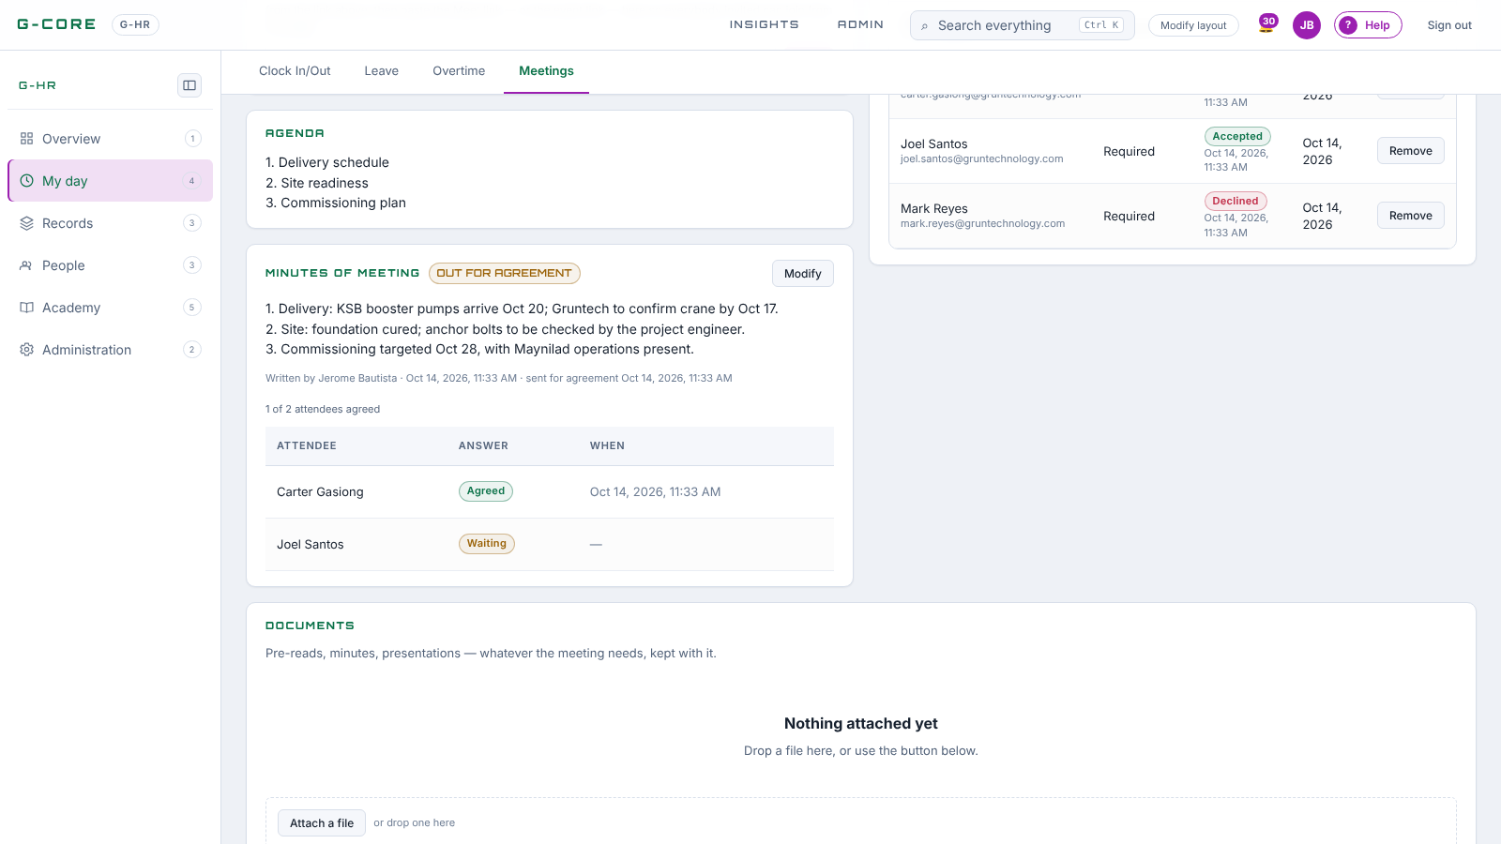
Minutes out for agreement
ON SCREEN · MEETINGS
1
Written after the start, sent to those who went.
2
Each attendee agrees or asks for a change.
3
All agreed → AGREED; Print gives the signed minutes.
Notes:
Live screen from G-CORE. Point at each numbered item, then switch to the browser and do it for real.

Slide 30

10-minute break
Back at 10:45 for G-CHAIN procurement and G-FIN money out.
Notes:
Halfway point: the clock should read 10:35. If Project Management ran long, shorten the warehouse slides.

Slide 31
G-CHAIN procurement
PART 4 · 40 MINUTES · 10:45
Procurement: Purchase Requests · RFQ · Canvass · Purchase Orders
Warehouse: Incoming · Inventory · Outgoing · Borrow Slips · Pull-out Slips
Notes:
Two strips in G-CHAIN. Procurement buys; the warehouse receives, keeps and releases.

Slide 32
From a need to goods on site
G-CHAIN
Document | Who raises it | Approved by | Moves money
Purchase request | Engineer, TM, TL, Industry Spec. | Technical Manager › Team Leader | Commits the budget
RFQ | Procurement | — (an enquiry) | Nothing
Canvass | Procurement | Awarded by procurement | Nothing
Purchase order | Procurement, Back Support | Purchasing Mgr (+ CEO > ₱100k) | Re-commits at price
Incoming | Warehouse | Back Support › Purchasing Mgr | Incurs the cost
Outgoing | Warehouse | Issuer’s supervisor | Charges the project
Direct-to-job purchases charge the project at receiving. Stock purchases build inventory and charge a project only when issued.
G-CORE Training · G-CHAIN · The flow
Notes:
The one rule procurement must not break: the two purchase kinds stay separate, or a project is charged twice for the same material.

Slide 33
A full-page requisition with a live budget
G-CHAIN · PURCHASE REQUEST
Start from the project’s Purchase Requisition tab — project fixed, direct to project. Stock replenishment starts from the G-CHAIN register.
BUDGET — LIVE
Fill lines three ways: type and pick (costing lines, item master), Add from costing…, or Import CSV / paste a block.
Beside the lines: available per budget line, less what you ask for.
Red = over. Over budget is refused at submit while the over-budget guard is on.
Each line: budget line, part no., item, unit, qty, estimated unit cost. A preferred supplier fills from the costing’s suppliers.
Route: Technical Manager › Team Leader. Approved, it commits the estimate.
G-CORE Training · G-CHAIN · Purchase Requests
Notes:
Demo: from the project tab, Add from costing, untick two lines, change a quantity and watch the budget panel. Submit to show the route.

Slide 34
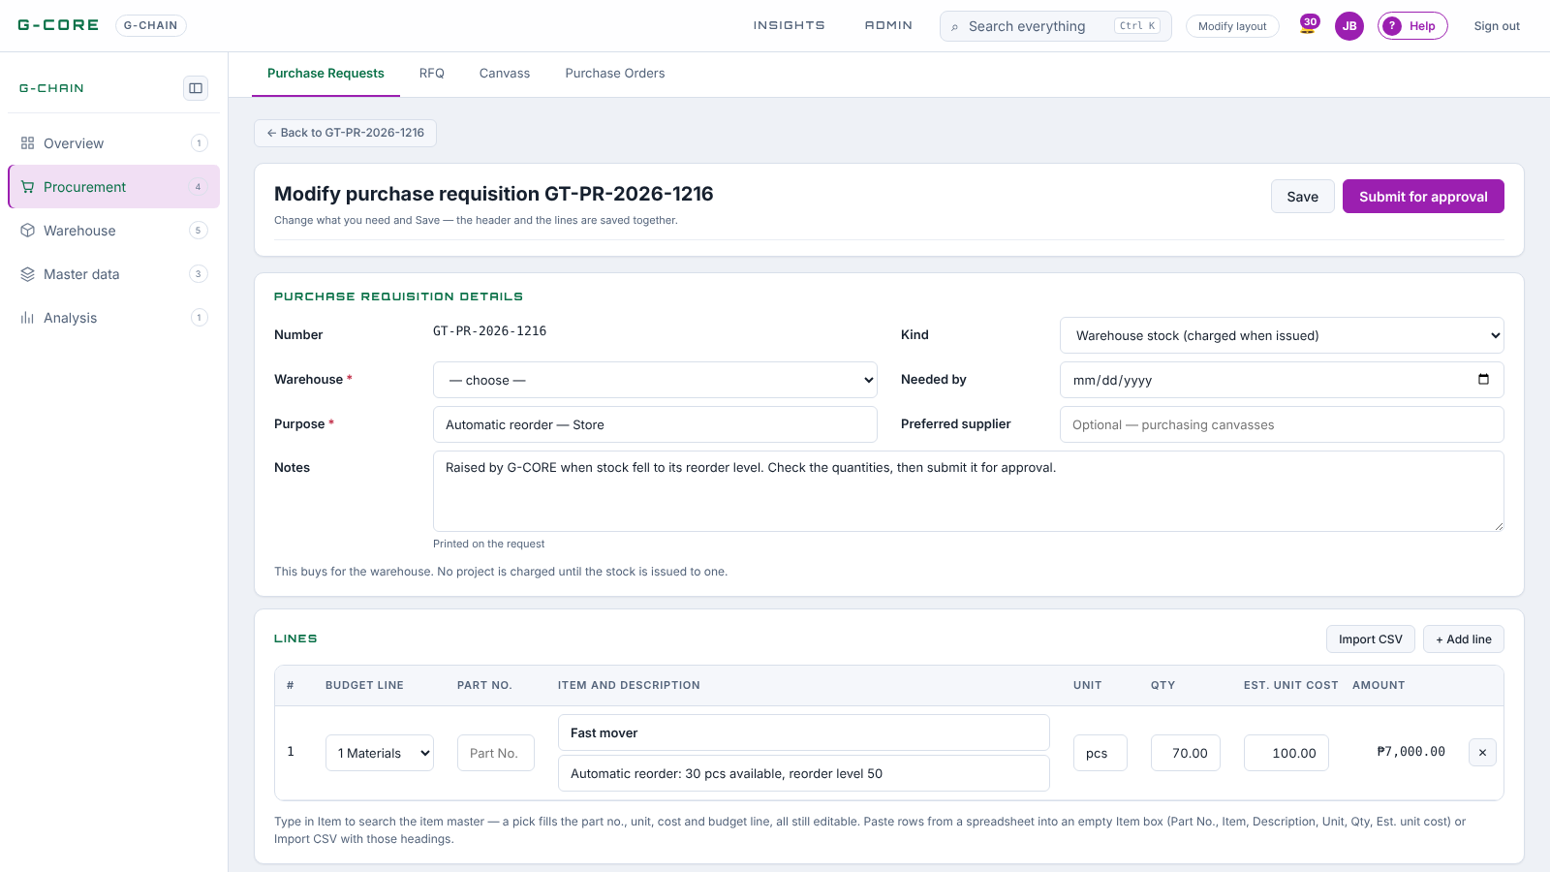
The purchase requisition page
ON SCREEN · G-CHAIN PROCUREMENT
1
Header: kind, project or warehouse, purpose, needed by.
2
Lines: budget line, part no., item, qty, est. cost.
3
Import CSV or paste rows from Excel.
Notes:
Live screen from G-CORE. Point at each numbered item, then switch to the browser and do it for real.

Slide 35
Ask suppliers, compare, award
G-CHAIN · RFQ AND CANVASS
Request for Quotation
Canvass sheet
From an approved PR: “Request quotations”
Tick the lines, add the suppliers asked
Print one paper per supplier — never another’s name or price
Mark sent, then record each supplier’s quote per line and attach their paper
“Start canvass” on the RFQ: up to six suppliers side by side
Reference budget = the PR’s estimate; savings in pesos and %
Recommend a column, then Award — the RFQ closes
The landscape Canvass Sheet signs Canvassed by and Awarded by
G-CORE Training · G-CHAIN · RFQ and Canvass
Notes:
Printed only, no email. A partial quote says “n of m lines” and is never called the lowest complete quote. After the award, “Raise order” takes only the lines the winner quoted.

Slide 36
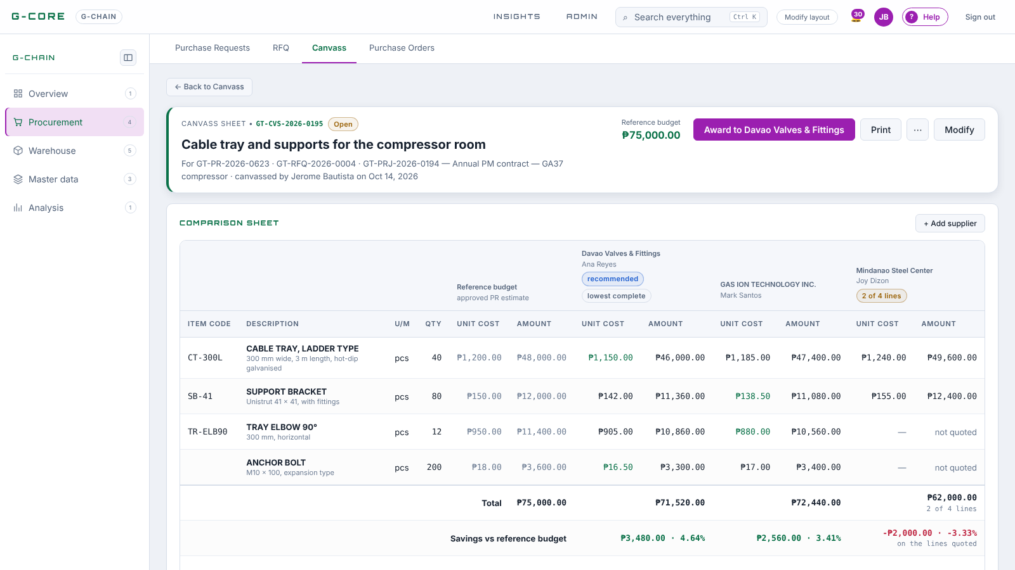
The canvass comparison sheet
ON SCREEN · G-CHAIN PROCUREMENT
1
Reference budget vs each supplier, line by line.
2
Savings vs the budget, in pesos and %.
3
Recommend, then Award to the winner.
Notes:
Live screen from G-CORE. Point at each numbered item, then switch to the browser and do it for real.

Slide 37
Order it, then receive it
G-CHAIN · PURCHASE ORDER AND INCOMING
Purchase order
Incoming report
Full page, pre-filled from the PR or the awarded canvass
Budget panel shows what is left after issue
Route: Purchasing Manager; + CEO above ₱100,000
The paper goes to the supplier: Supplier and Ship to blocks, no internal notes
“Receive goods” on the PO: what is ordered, received, left
Or without a PO — supplier, reason, items into stock
Attach the DR, packing list and photos
Route: Back Support › Purchasing Manager. A draft moves nothing; approval posts stock and cost
G-CORE Training · G-CHAIN · Purchase Orders and Incoming
Notes:
Only RECEIVED goods count anywhere money looks: a supplier bill is matched to a received report only.

Slide 38
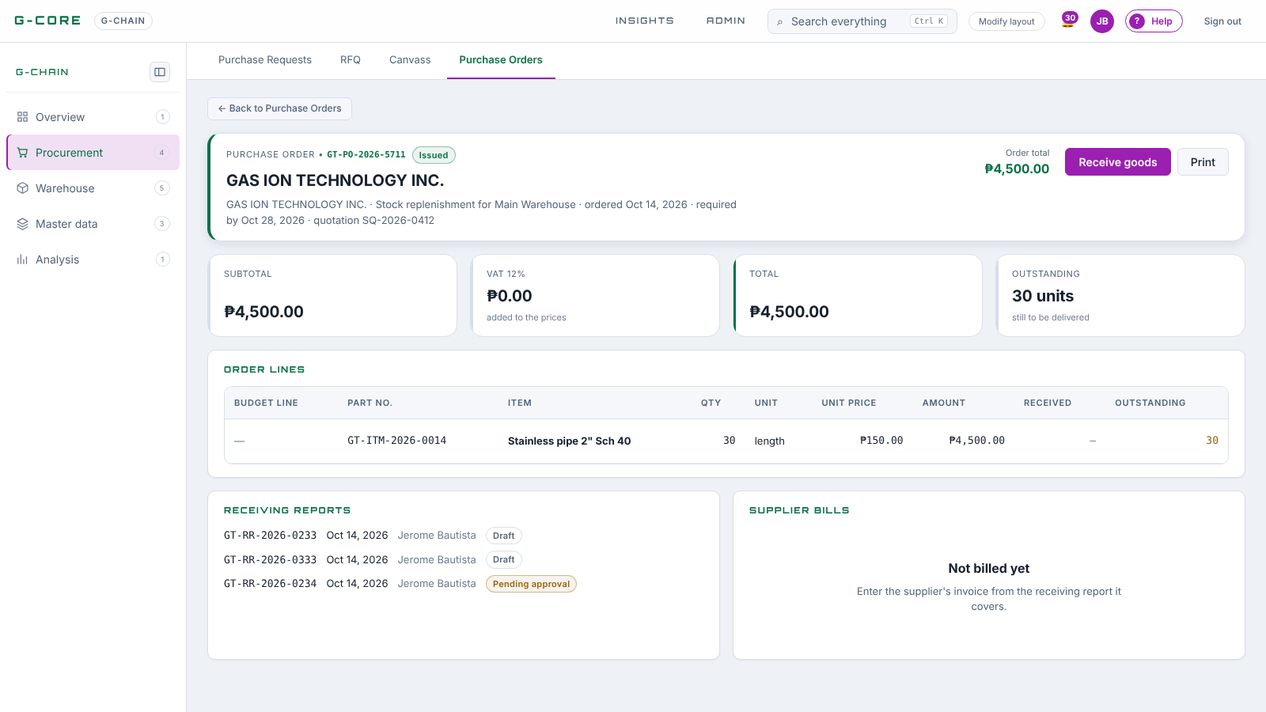
An issued purchase order
ON SCREEN · G-CHAIN PROCUREMENT
1
Receive goods opens the Incoming report.
2
Received and outstanding per line.
3
Supplier bills appear once A/P records them.
Notes:
Live screen from G-CORE. Point at each numbered item, then switch to the browser and do it for real.

Slide 39
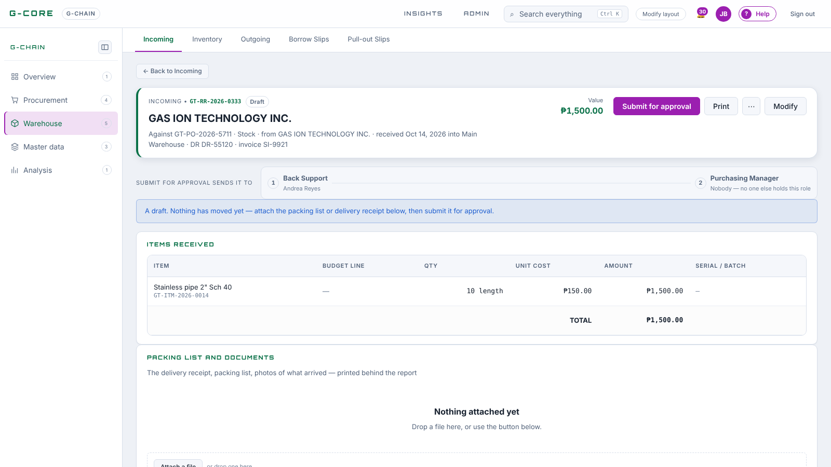
An Incoming report, before approval
ON SCREEN · G-CHAIN WAREHOUSE
1
A draft moves no stock.
2
Route: Back Support › Purchasing Manager.
3
Attach the DR and packing list.
Notes:
Live screen from G-CORE. Point at each numbered item, then switch to the browser and do it for real.

Slide 40
Keeping and releasing stock
G-CHAIN · WAREHOUSE
Inventory
Outgoing — receive proof
Cards, category tiles, stock status (In stock · Low · Critical · On order), List or Kanban. Low stock raises a draft reorder PR for the supervisor to submit.
Issue to a person or project; the requestor confirms receipt. Prints as a Delivery Receipt, no prices.
Pull-out slip — release
Borrow slip — anyone
From an issued sales order, a PR, or no source (supplier return, testing). Courier block and gate clearance on paper.
Team Leader / Technical Manager › Warehouse Supervisor approve; warehouse releases; return clearance records condition.
G-CORE Training · G-CHAIN · Warehouse
Notes:
Borrowing never charges the project: the item leaves “available” but stays owned. A pull-out from a PR reduces what is left to order, so the project takes from the shelf instead of buying.

Slide 41
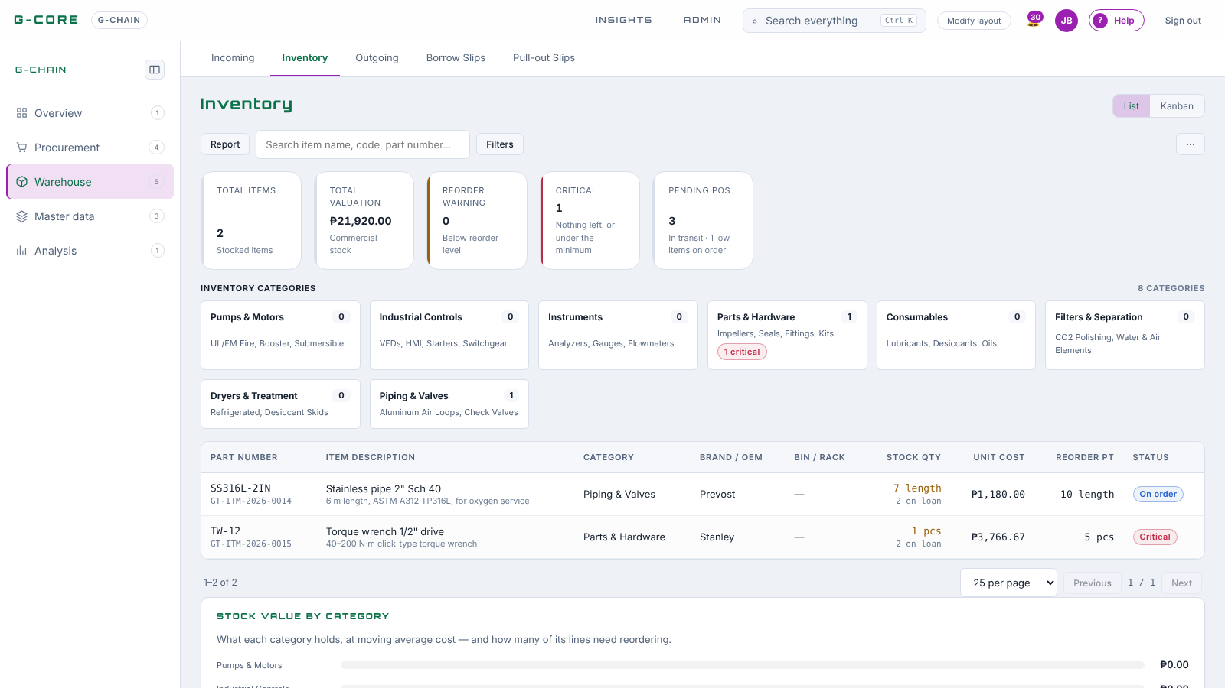
Inventory
ON SCREEN · G-CHAIN WAREHOUSE
1
Cards: items, valuation, reorder, critical, pending POs.
2
Category tiles filter the list.
3
Status: In stock, Low, On order, Critical.
Notes:
Live screen from G-CORE. Point at each numbered item, then switch to the browser and do it for real.

Slide 42
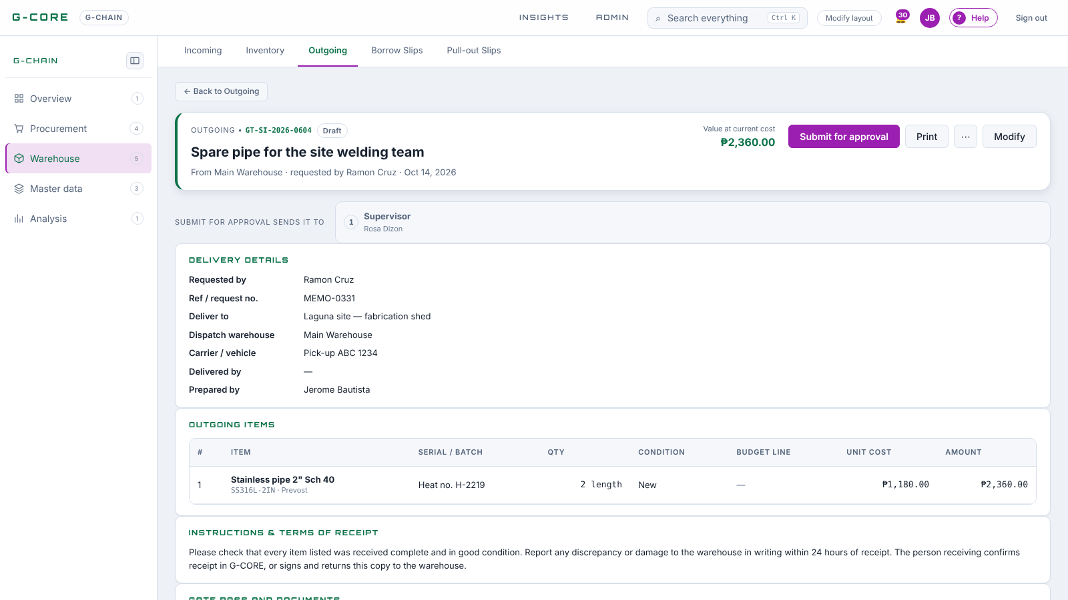
An Outgoing slip (Delivery Receipt)
ON SCREEN · G-CHAIN WAREHOUSE
1
Requested by, deliver to, carrier.
2
Items with serial and condition — no prices.
3
The receiver confirms receipt in G-CORE.
Notes:
Live screen from G-CORE. Point at each numbered item, then switch to the browser and do it for real.

Slide 43
A Report button on every list
G-CHAIN · REPORTS
Every G-CHAIN list has a Report button beside its “+ New”. It opens that menu’s report over a period you choose.
TRY IT
Purchase Orders › Report › Last 12 months → the supplier-by-month matrix.
Presets: This month · Last month · This quarter · Year to date · Last 12 months — or type the dates.
Incoming › Report → goods received by month, by quantity and value.
Export CSV or Print. Every figure is read from the documents themselves.
G-CORE Training · G-CHAIN · Reports
Notes:
Keep this to three minutes. The point: nobody keeps a spreadsheet beside G-CORE any more.

Slide 44
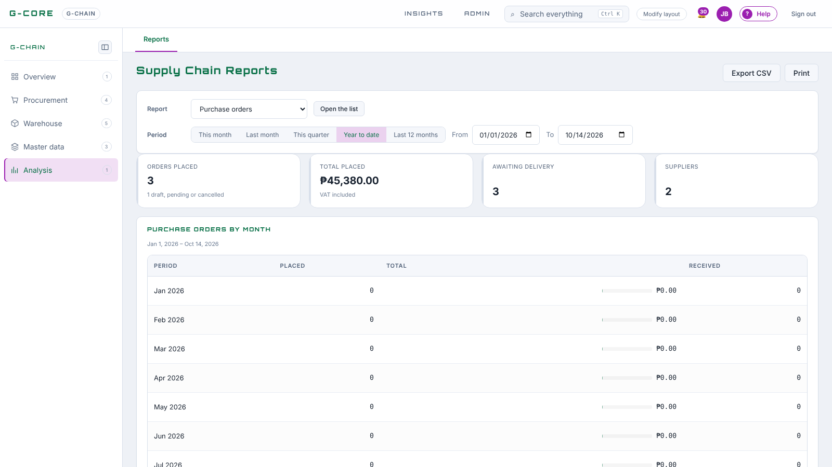
Supply Chain Reports
ON SCREEN · G-CHAIN
1
Pick a report per menu.
2
Period presets or your own dates.
3
Export CSV or Print.
Notes:
Live screen from G-CORE. Point at each numbered item, then switch to the browser and do it for real.

Slide 45
G-FIN money out
PART 5 · 25 MINUTES · 11:25
Budget Requests · Budget Liquidations · Reimbursements · Cash Advances
Notes:
For the project team: how to get cash and account for it. For finance: how to release, check and close.

Slide 46
Three ways money goes out to people
G-FIN · WHICH ONE DO I USE?
Budget request
Reimbursement
Cash advance
Project cash before you spend. Always names a project (office cash goes against an operations project). Liquidated afterwards.
You already paid from your pocket. Itemised claim with receipts attached; paid back once approved.
Money lent to an employee. Repaid in payments, salary deduction included. Not for project purchases.
Buying materials or a service for a project? That is a purchase requisition in G-CHAIN — a budget request is for cash the team spends directly.
G-CORE Training · G-FIN · Money out
Notes:
Ask the room for an example of each before showing the answer. Most confusion is between a budget request and a purchase requisition.

Slide 47
Project cash: request → release
G-FIN · BUDGET REQUEST
1 · REQUEST
2 · APPROVE
3 · RELEASE
From the project’s Budget Requests tab, or “+ Add budget request” in G-FIN: project, budget line, amount, date needed, purpose.
Team Leader › Back Support › Finance Manager, plus CEO / President above ₱100,000.
Finance releases it in one voucher. The liquidation deadline starts counting.
Approval and release post nothing to the project. Cost reaches the project only when the liquidation is approved — at what was actually spent.
G-CORE Training · G-FIN · Budget Requests
Notes:
Finance’s register: cards for the sum requested, approved funds, pending approval and to release. Each card opens the list it counts.

Slide 48
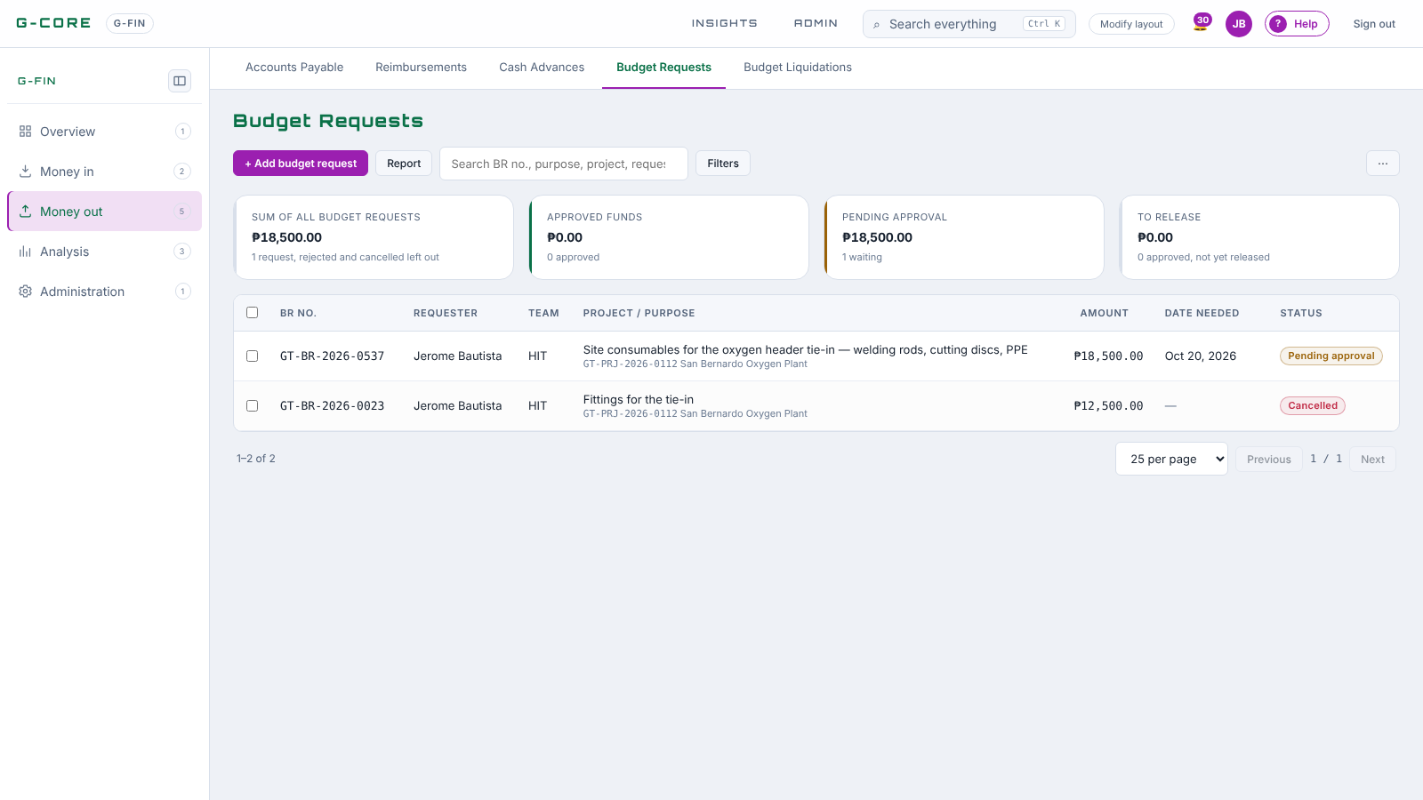
The Budget Requests register
ON SCREEN · G-FIN MONEY OUT
1
Cards: total, approved funds, pending, to release.
2
BR No., requester, team, project, date needed.
3
+ Add budget request.
Notes:
Live screen from G-CORE. Point at each numbered item, then switch to the browser and do it for real.

Slide 49
Account for every peso released
G-FIN · BUDGET LIQUIDATION
Only the requester files it, once the cash is released: “Actual entry” in Budget Liquidations, or Liquidate on the request page.
EXAMPLE
Itemised lines with receipts attached — the files go with it from the first approval step.
Item | ₱
Released | 50,000
Spent (liquidated) | 42,000
Returned | 8,000
Spent less? The change is returned (“Process”) and recorded. Spent more? The difference is reimbursed.
Status: Released → Refund due → Liquidated. The project is charged 42,000.
G-CORE Training · G-FIN · Budget Liquidations
Notes:
The liquidation goes through the reimbursement route (next slide). The Budget Liquidations register shows overdue ones; chase those first.

Slide 50
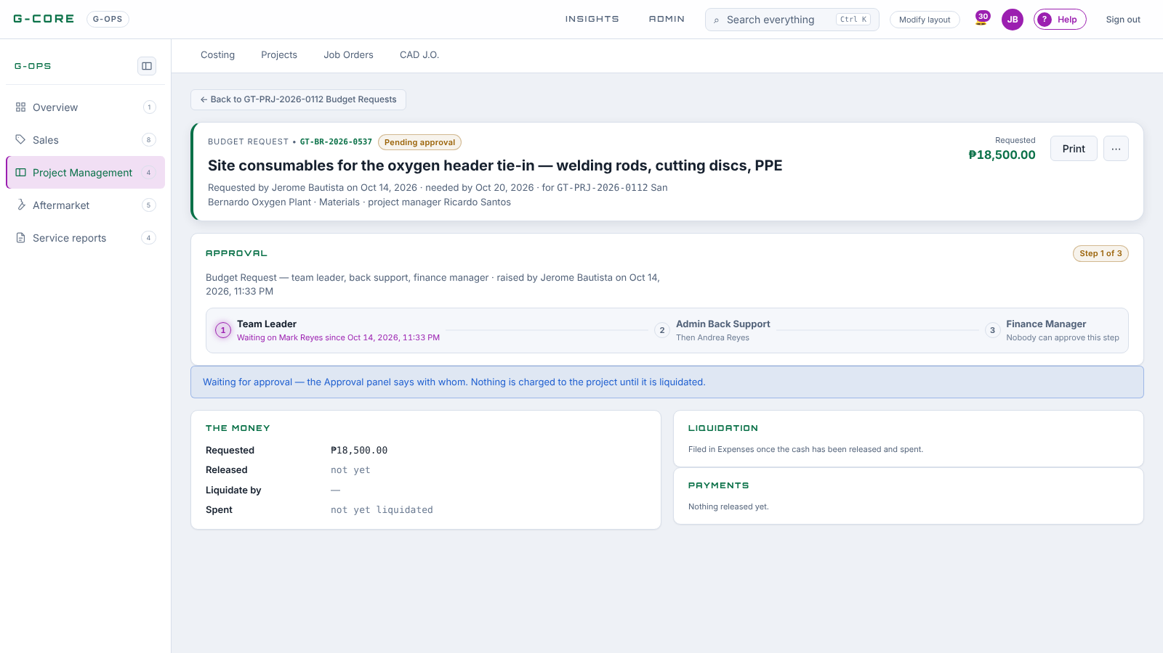
A budget request page
ON SCREEN · G-FIN MONEY OUT
1
Approval panel: who it waits on.
2
The money: requested, released, liquidate by, spent.
3
Liquidation and payments on the right.
Notes:
Live screen from G-CORE. Point at each numbered item, then switch to the browser and do it for real.

Slide 51
Five signatures, status in plain words
G-FIN · REIMBURSEMENTS
TL APPROVAL
BACK SUPPORT
CHECKING
FM APPROVAL
CEO APPROVAL
Team Leader
Admin Back Support
Finance Staff
Finance Manager
CEO / President
Filing one
Reading the list
“+ Add reimbursement”: lines (date, what, amount, project and budget line), receipts in Attachments at the foot, Submit.
Status shows the step it waits on, then For Release, then Paid. Cards: total, pending, for release, paid out.
G-CORE Training · G-FIN · Reimbursements (also every liquidation)
Notes:
Same five steps for every reimbursement and every budget liquidation, and for cash advances. Someone who holds two steps signs both with one Approve.

Slide 52
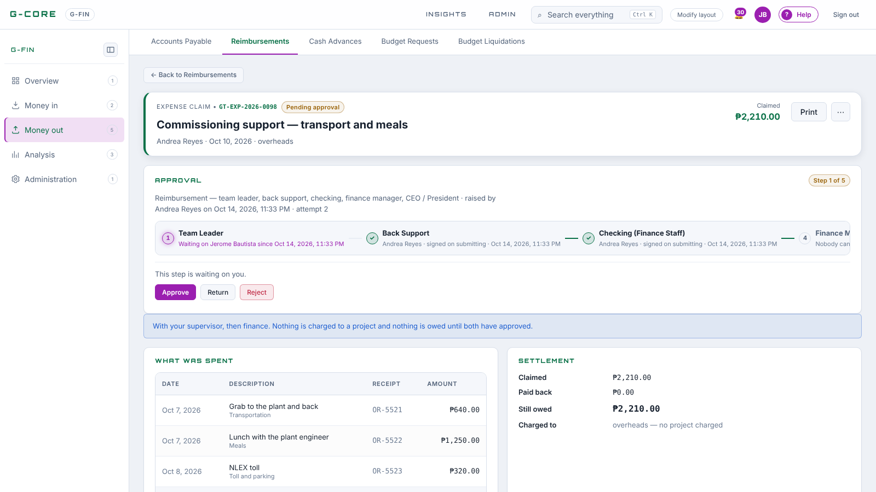
A reimbursement waiting on its approver
ON SCREEN · G-FIN MONEY OUT
1
Each receipt line with its OR no.
2
Settlement: claimed, paid back, still owed.
3
Charged to the project, or overheads.
Notes:
Live screen from G-CORE. Point at each numbered item, then switch to the browser and do it for real.

Slide 53
Money lent, repaid in payments
G-FIN · CASH ADVANCE
Request & approve
Release & repay
Track the balance
Amount and purpose; the same five steps as a reimbursement. One advance at a time per person.
Released in one voucher. Repayments by cash, cheque or salary deduction, entered by finance with Payment entry.
Status: Repaying while a balance is owed, then Paid. The page shows the payment history.
An advance is never liquidated with receipts. Need cash for a project? Use a budget request.
G-CORE Training · G-FIN · Cash Advances
Notes:
Older advances raised before the change keep their liquidation. Every new one is a loan.

Slide 54
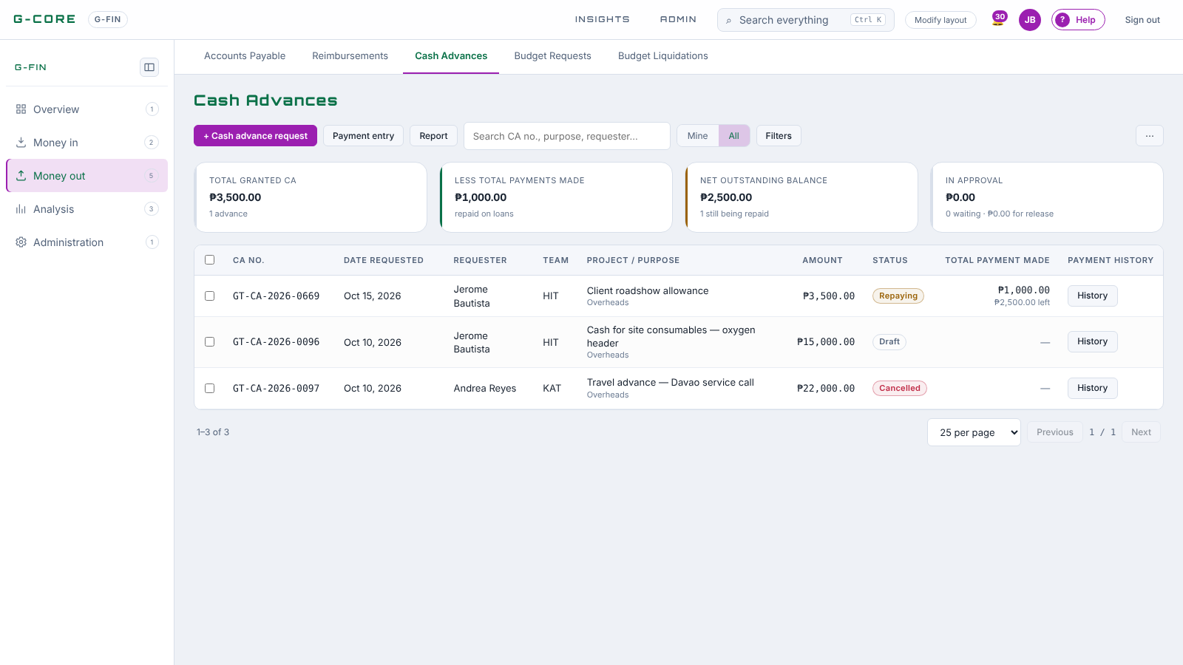
Cash Advances
ON SCREEN · G-FIN MONEY OUT
1
Granted, repaid, net outstanding.
2
Repaying until the balance is zero.
3
Payment entry: cash or salary deduction.
Notes:
Live screen from G-CORE. Point at each numbered item, then switch to the browser and do it for real.

Slide 55
Who signs what
CHEAT SHEET · APPROVAL ROUTES
Document | Route after the preparer
Costing | Technical Manager › Team Leader
Job order | Technical Manager (named as PM) › Team Leader
Request for Approval | Technical Manager › Team Leader (+ CEO over ₱1,000,000)
Accomplishment report · Billing | Technical Manager › Team Leader
Purchase request | Technical Manager › Team Leader
Purchase order | Purchasing Manager (+ CEO over ₱100,000)
Incoming | Back Support › Purchasing Manager
Budget request | Team Leader › Back Support › Finance Manager (+ CEO over ₱100,000)
Reimbursement · Liquidation · Cash advance | Team Leader › Back Support › Checking › Finance Manager › CEO
G-CORE Training · Approval routes
Notes:
Technical Manager and Back Support are team-scoped: the one on the preparer’s own team is asked. Team Leader is the preparer’s “Reports to”, else a Team Leader on their team. The Project Manager is the Technical Manager: pick the Technical Manager in a job order’s Project manager field.

Slide 56
A step nobody holds is a document that stalls
BEFORE GO-LIVE
Roles to assign in Admin › Users
On every person
Technical Manager · Team Leader · Back Support · Purchasing Manager · Finance Manager · Finance (Checking) · Warehouse Supervisor · CEO / President
Reports to (their Team Leader) and Team (KAT, HIT, UIT, GIB, SIT). Back Support: tick the teams they support.
[Fill in before the session: who holds each role, by name]
G-CORE Training · Roles
Notes:
Admin runs the workflow audit after setting roles; it lists every step nobody holds. Fix those before the afternoon lab, or trainees’ documents will refuse to submit.

Slide 57
Build a real project, end to end
1:00 – 4:00 PM · HANDS-ON
Each of you does your own part, in your own login, on one live project.
Notes:
Choose the project before the session: a real, small, newly won job so the data entered stays useful. [Project name / quotation number]

Slide 58
Four rounds, one project
AFTERNOON PLAN
Round | Who does it | Done when
1 · Set up 1:00 – 1:45 | Engineer, TM, TL, Sales | Costing FINAL, job order approved, project built
2 · Plan 1:45 – 2:15 | Engineer, Technical Manager | Gantt planned, kick-off meeting with minutes agreed
3 · Buy 2:15 – 3:05 | Engineer, Procurement, Warehouse | PR approved, RFQ, canvass awarded, PO issued, goods received
4 · Report & pay 3:05 – 3:45 | Engineer, Finance, approvers | Budget request released, liquidated; report and billing approved
Approvers stay on My Work the whole afternoon — every document waits on someone in this room. Wrap-up and go-live: 3:45 – 4:00.
G-CORE Training · Afternoon
Notes:
Round 1 45 min, round 2 30 min, round 3 50 min, round 4 40 min, wrap-up and go-live 15 min — 1:00 to 4:00. Round 3 is the longest because three people hand the purchase on.

Slide 59
Tick each step as it lands
AFTERNOON CHECKLIST
1 · Costing: lines, scope, start date — submit
8 · RFQ to two suppliers, record quotes
2 · TM and TL approve → FINAL
9 · Canvass, award, raise the PO, approve
3 · Sales: job order on the quotation — submit
10 · Incoming report with the DR — approve
4 · Technical Manager and TL approve → project built
11 · Budget request — approve, release
5 · Scope of Work: Plan from costing, task weights
12 · Liquidation with receipts — approve
6 · Kick-off meeting: invite, minutes, agree
13 · Accomplishment report: a day + pictures
7 · Purchase request from costing — approve
14 · Billing — approve; check Budget Monitoring
G-CORE Training · Afternoon checklist
Notes:
Print this slide for each table. The last check, Budget Monitoring, should show the PO committed, the receipt incurred and the liquidation incurred — the whole morning in one screen.

Slide 60



From tomorrow, it runs in G-CORE
DEPLOYMENT
People
Data
Habits
Every trainee signed in, Reports to and Team set, roles assigned; the workflow audit shows no empty step.
Running projects entered, suppliers and items loaded (CSV import), warehouse opening stock received.
No paper PR, PO or cash request outside G-CORE. Check My Work every morning. Problems go in ? Help.
G-CORE Training · Go-live
Notes:
Agree the cut-over date in the room: [date]. From then, a document that is not in G-CORE did not happen.

Slide 61
Documents move the money.
Approvals move the documents.
QUESTIONS
Lunch, then we build the project together.
gruntech.gcore.tech · ? Help in the top bar · Trainer: [Name]
Notes:
Collect the parking-lot questions; answer them at the start of the afternoon.

Slide 62
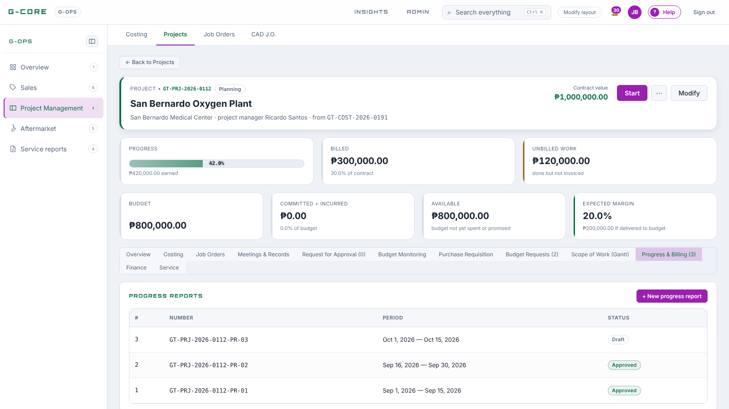
Progress & Billing tab
ON SCREEN · PROJECT MANAGEMENT
1
Every report of the project, numbered in order.
2
+ New progress report carries the last figures forward.
3
Billings raised from approved reports.
Notes:
Live screen from G-CORE. Point at each numbered item, then switch to the browser and do it for real.

Slide 63
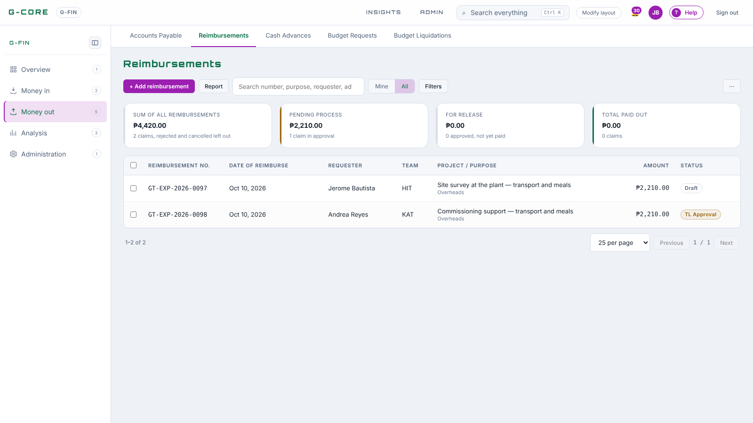
The Reimbursements register
ON SCREEN · G-FIN MONEY OUT
1
Cards: total, pending, for release, paid out.
2
Status in plain words: TL Approval, Checking …
3
+ Add reimbursement.
Notes:
Live screen from G-CORE. Point at each numbered item, then switch to the browser and do it for real.

